Slide 1
Respiratory Disease Detection using Meta Learning
CS584 Project
Akshaya Brian Tauro

Slide 2
Problem Statement
Annotations of novel diseases is very costly in-terms of labor intensive, time, prone to error even when labelled by experienced doctors
However, to address this issue, transfer learning were proposed but here the drawback is sufficient labeled data should be available in the target domain

Slide 3
Technique to handle less annotated data?
One of the technique is meta-learning, FEW SHOT

Slide 4
meta-learning?
Few-Shot Learning is an example of meta-learning, where a learner is trained on several related tasks, during the meta-training phase, so that it can generalize well to unseen (but related) tasks with just a few examples.
N-way-K-Shot-classification, N – number of classes , K – number of samples in each class to train on.
Training experience gained from attempting to solve TRAIN tasks will be used to solve the TEST task
https://www.v7labs.com/blog/few-shot-learning-guide, https://neptune.ai/blog/understanding-few-shot-learning-in-computer-vision

Slide 5
The importance of Few-Shot Learning
Learn for anomalies
Reduce data costs
Learn like a human
https://www.v7labs.com/blog/few-shot-learning-guide
Notes:
test

Slide 6
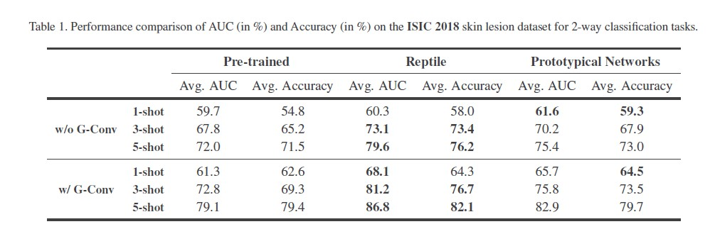
Motivation
TCS research group worked on few-Shot Skin Disease Identification using Meta-Learning.
Kushagra Mahajan, Monika Sharma, and Lovekesh Vig. Meta-dermdiagnosis: Few-shot skin disease identification using meta-learning. In 2020 IEEE/CVF Conference on Computer Vision and Pattern Recognition Workshops (CVPRW), pages 3142–3151, 2020.

Slide 7
Reptile : first order GRADIENT-BASED META-LEARNING?
Works by repeatedly sampling a task, training on it, and moving the initialization towards the trained weights on that task
Reptile learns an initialization for the parameters of a neural network model, such that when we optimize these parameters at test time, learning is fast.

Slide 8
Reptile – Gradient based – Meta Learning
Quickly adapt to a new task
Need few annotated examples

Slide 9
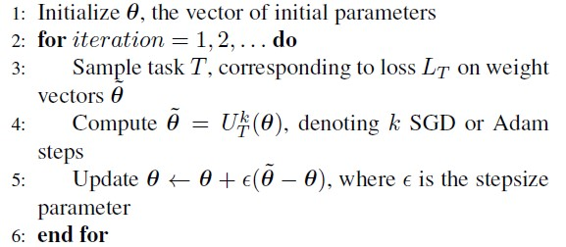
Reptile Algorithm
Kushagra Mahajan, Monika Sharma, and Lovekesh Vig. Meta-dermdiagnosis: Few-shot skin disease identification using meta-learning. In 2020 IEEE/CVF Conference on Computer Vision and Pattern Recognition Workshops (CVPRW), pages 3142–3151, 2020.

Slide 10
Respiratory Disease Detection using Meta Learning
Meta-learning based few-shot approach like Reptile algorithm which is the gradient based method is used to detect novel disease like COVID19, and other common respiratory diseases like Pneumonia and Tuberculosis.

Slide 11
Chest X-ray Dataset (4675 Images )
Train (3053 ) | Validation (787 ) | Test (830 )
COVID19 (368 ) | COVID19 (100 ) | COVID19 (106 )
NORMAL (1080 ) | NORMAL (268 ) | NORMAL (234 )
PNEUMONIA (1135 ) | PNEUMONIA (288 ) | PNEUMONIA(390 )
TUBERCULOSIS (470 ) | TUBERCULOSIS (131 ) | TUBERCULOSIS (100 )

Slide 12
Experiments overview
 | META DATASET (20) | COMPLETE DATASET (4670)
META LEARNING | Yes | No
CLASSICAL CNN | Yes | Yes
TRANSFER LEARNING | Yes | Yes
Total 5 experiments

Slide 13
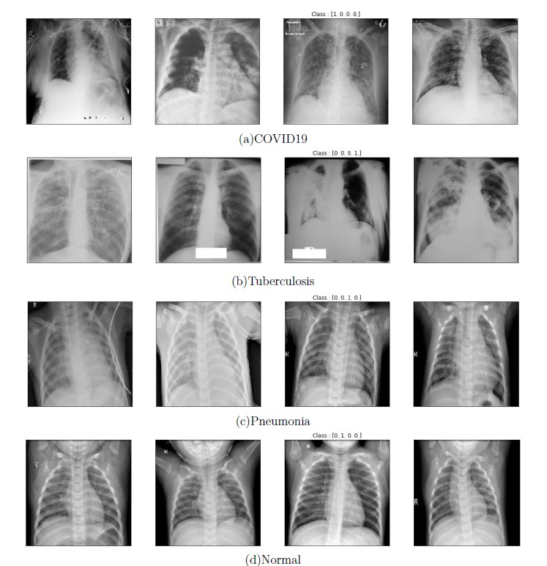
IMAGES FROM THE ORIGINAL DATASET

Slide 14
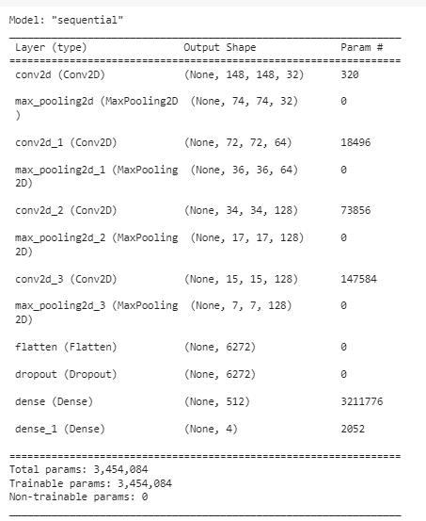
IMPLEMENTATION
Image dimension foe all the experiments : 150 X 150 X 1
NEURAL NETWORK:
Input layer – conv 2d (32 units, 3 x 3) , ACTIVATION - Relu
Hidden layers
conv 2d (32 units, 3 x 3), MAXPOOLING2D(2X2) , ACTIVATION - Relu
conv 2d (64 units, 3 x 3), MAXPOOLING2D(2X2) , ACTIVATION - Relu
conv 2d (128 units, 3 x 3), MAXPOOLING2D(2X2) , ACTIVATION - Relu
conv 2d (128 units, 3 x 3), MAXPOOLING2D(2X2), , ACTIVATION - Relu
FLATTEN
DROPOUT(0.5)
DENSE (512)
OUTPUT layer – DENSE(4), ACTIVATION – SOFTMAX
METRIC - Accuracy
META LEARNING: OPTIMIZER – SGD
CNN & TRANSFER LEARNING : OPTIMIZER - RMSprop

Slide 15
IMPLEMENTATION
IMAGE DIMENSION - : 200 X 200 X 3
U-Shaped NETWORK:
Input layer – IMAGES WITH DIMENSION 200 X 200 X 3
Rescaling layer – Scales by a factor 1./255
ENCODER PART:
conv2d (32 units, 3 x 3), MAXPOOLING2D (2X2) , ACTIVATION – Relu, PADDING – SAME
conv2d (64 units, 3 x 3), MAXPOOLING2D (2X2) , ACTIVATION – Relu, PADDING – SAME
Bottleneck layer - conv2d (128 units, 3 x 3), ACTIVATION – Relu, PADDING – SAME , DROPOUT = 0.5
DECODER PART:
Upsampling2d (2X2), Concatenate, conv2d (64 units, 3x3), MAXPOOLING2D (2X2) , ACTIVATION – Relu, PADDING – SAME
Upsampling2d (2X2), Concatenate , conv2d (32 units, 3x3), MAXPOOLING2D (2X2) , ACTIVATION – Relu, PADDING – SAME
OUTPUT layer – conv2d (num_classes, 1 x 1), ACTIVATION – SOFTMAX
METRIC - mean Intersection over Union (IoU)
LOSS – sparse categorical cross-entropy
OPTIMIZER - RMSprop

Slide 17
rESULTS
 | Iterations | Epochs | TRAIN ACCURACY | TEST ACCURACY
META LEARNING - FEW SHOT | 1000 | - | 25 | 50
CLASSICAL CNN - META DATA | - | 1/15 | 20 | 25
TRANSFER LEARNING - META DATA | - | 2/15 | 35 | 30
CLASSICAL CNN - COMPLETE DATASET | - | 9/15 | 88 | 75
TRANSFER LEARNING -COMPLETE DATASET | - | 15/15 | 88 | 86

Slide 18
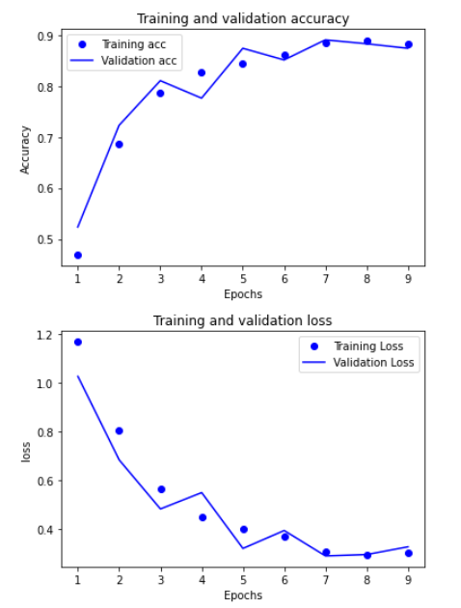
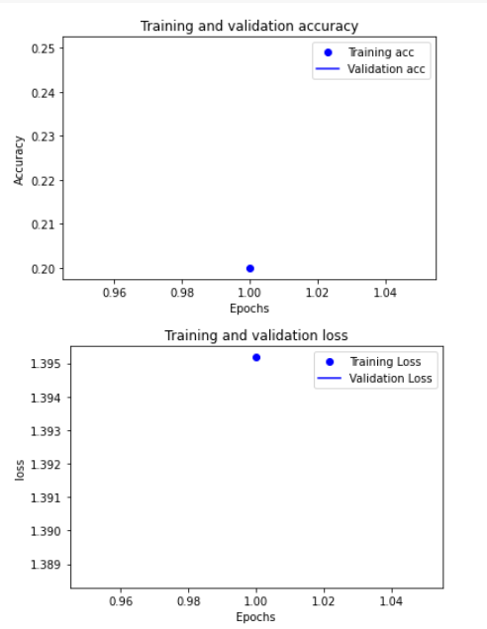
CLASSIC CNN complete data meta data

Slide 19
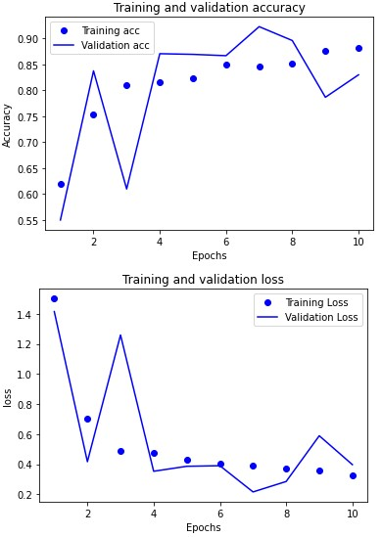
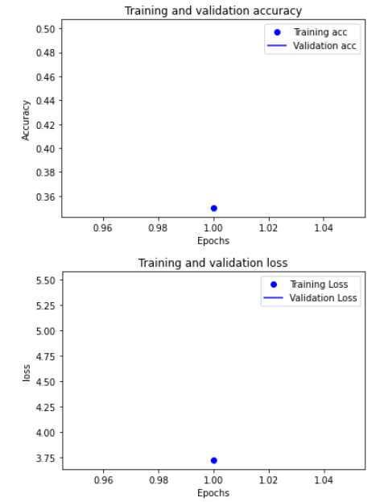
Transfer learning Complete dataset META dataset

Slide 20
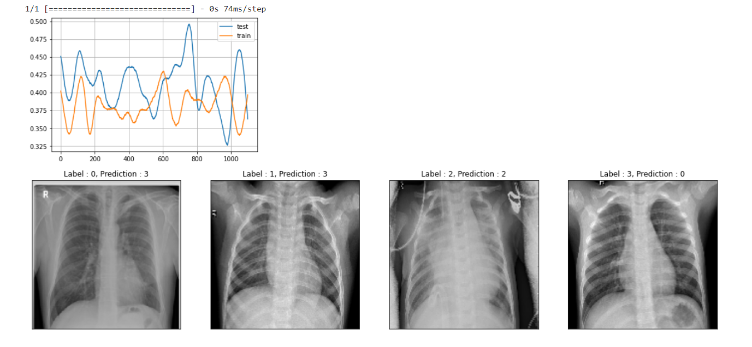
REPTILE ALGORITHM

Slide 21
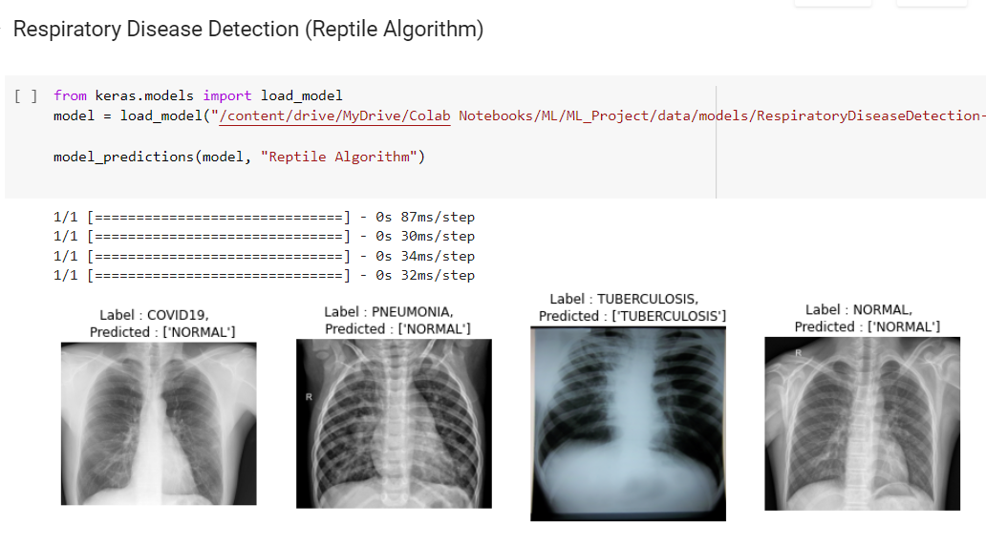
MODEL PREDICTIONS
 | Total Correct Predictions
META LEARNING - FEW SHOT | 2
CLASSICAL CNN - META DATA | 1
TRANSFER LEARNING - META DATA | 1
CLASSICAL CNN - COMPLETE DATASET | 2
TRANSFER LEARNING -COMPLETE DATASET | 3

Slide 22
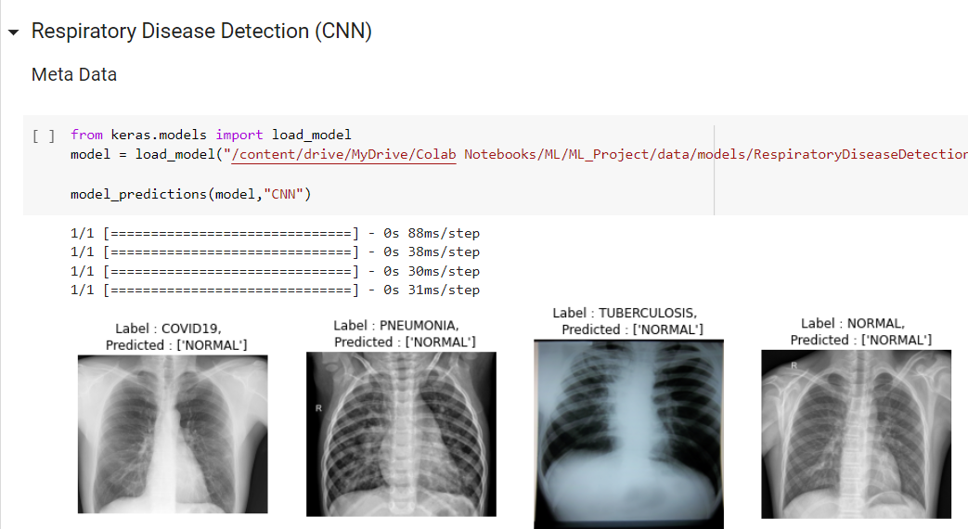
MODEL PREDICTIONS
 | Total Correct Predictions
META LEARNING - FEW SHOT | 2
CLASSICAL CNN - META DATA | 1
TRANSFER LEARNING - META DATA | 1
CLASSICAL CNN - COMPLETE DATASET | 2
TRANSFER LEARNING -COMPLETE DATASET | 3

Slide 23
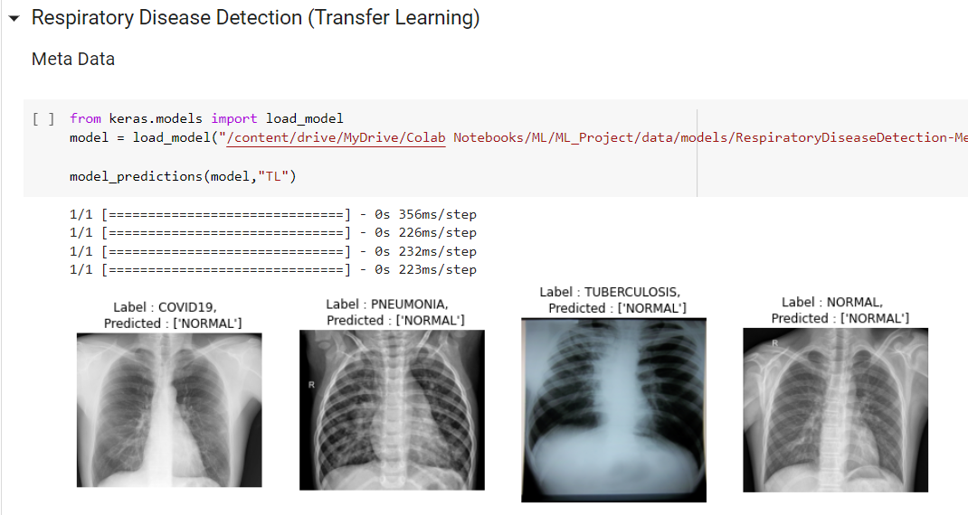
MODEL PREDICTIONS
 | Total Correct Predictions
META LEARNING - FEW SHOT | 2
CLASSICAL CNN - META DATA | 1
TRANSFER LEARNING - META DATA | 1
CLASSICAL CNN - COMPLETE DATASET | 2
TRANSFER LEARNING -COMPLETE DATASET | 3

Slide 24
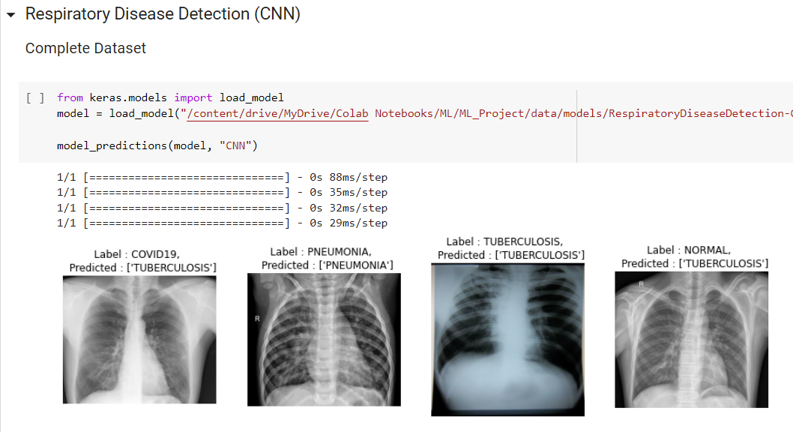
MODEL PREDICTIONS
 | Total Correct Predictions
META LEARNING - FEW SHOT | 2
CLASSICAL CNN - META DATA | 1
TRANSFER LEARNING - META DATA | 1
CLASSICAL CNN - COMPLETE DATASET | 2
TRANSFER LEARNING -COMPLETE DATASET | 3

Slide 25
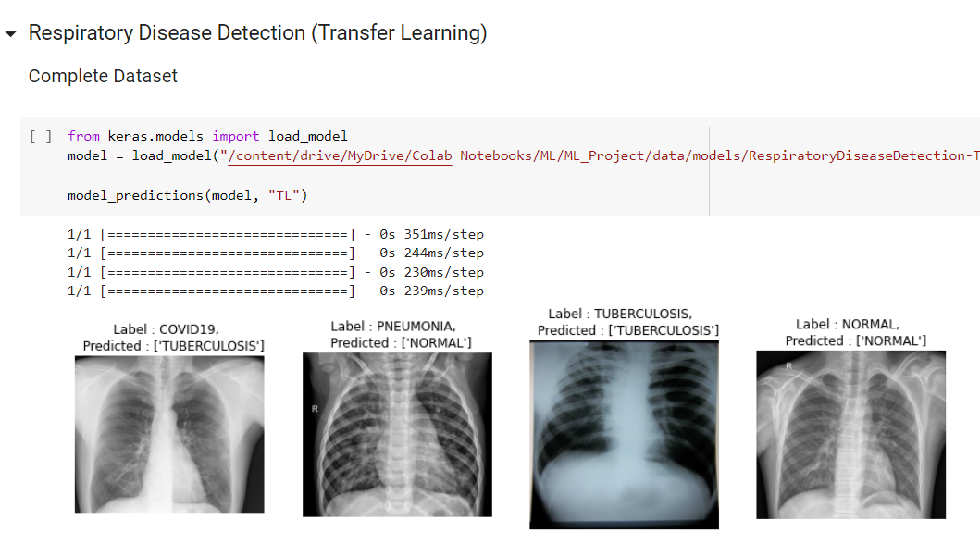
MODEL PREDICTIONS
 | Total Correct Predictions
META LEARNING - FEW SHOT | 2
CLASSICAL CNN - META DATA | 1
TRANSFER LEARNING - META DATA | 1
CLASSICAL CNN - COMPLETE DATASET | 2
TRANSFER LEARNING -COMPLETE DATASET | 3

Slide 26
CONCLUSIONS
With less annotated data META LEARNING performs better than TRANSFER LEARNING and classic cnn
For low data scenarios, Meta learning approach shows good results.

Slide 27
Future WORK
TO GET BEtter results, would like to run more experiments
To explore state-of-the-art approaches in meta-learning techniques, and adoption of these in health care domain to detect the novel diseases.

Slide 28
ANY QUESTIONS?

